Slide 1
CHAPTER 2 Requirements from the customer’s perspective

Slide 2
Read by yourself
Chapter 2
Who is the customer?
Differentiate stakeholders and customers
The gap between what the customer needs and what the developer builds
Parties involve the reaching agreements
What is requirements baseline?
The customer’s rights and customer’s responsibilities
Chapter 3
Requirements development process framework
The distribution of requirements development related in different type of SDLC
The goal of every phase in Requirements development process framework

Slide 3
Objectives
After finish this chapter, student should understand that the customer-development relationship is so critical to software project success.
This chapter also discusses the critical issue of reaching agreement on a set of requirements planned for a specific release or development iteration
Requirements Bill of Rights for Software Customers and a corresponding Requirements Bill of Responsibilities for Software Customers could bring to student the importance of customer—and specifically end user—involvement in requirements development.

Slide 4
Contents
The expectation gap
Who is the customer
The customer-development partnership
Requirements Bill of Rights for Software Customers
Requirements Bill of Responsibilities for Software Customers
Creating a culture that respects requirements
Identifying decision makers
Reaching agreement on requirements

Slide 5
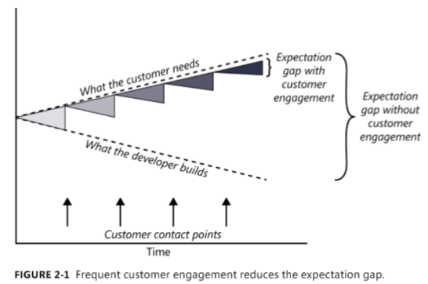
The expectation gap

Slide 6
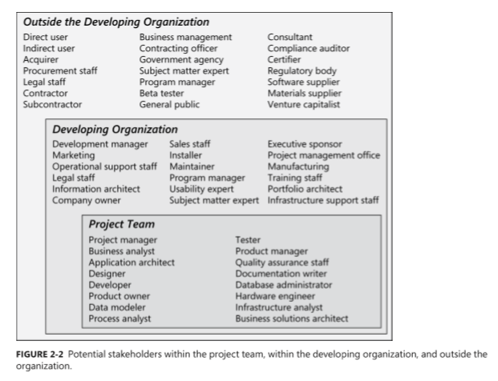
Who is the customer?

Slide 7
The customer-development partnership
Customers have the right to:
Expect BAs to speak your language.
Expect BAs to learn about your business and your objectives.
Expect BAs to record requirements in an appropriate form.
Receive explanations of requirements practices and deliverables.
Change your requirements.
Expect an environment of mutual respect.
Hear ideas and alternatives for your requirements and for their solution.
Describe characteristics that will make the product easy to use.
Hear about ways to adjust requirements to accelerate development through reuse.
Receive a system that meets your functional needs and quality expectations.
Notes:
Teacher should explain every the right of customers in requirements engineering activities

Slide 8
The customer-development partnership
Customers have the responsibility to:
Educate BAs and developers about your business.
Dedicate the time that it takes to provide and clarify requirements.
Be specific and precise when providing input about requirements.
Make timely decisions about requirements when asked.
Respect a developer’s assessment of the cost and feasibility of requirements.
Set realistic requirement priorities in collaboration with developers.
Review requirements and evaluate prototypes.
Establish acceptance criteria.
Promptly communicate changes to the requirements.
Respect the requirements development process
Notes:
Teacher should explain every the responsibility of customers in requirements engineering activities

Slide 9
Identifying decision makers
decision leader
decision rule
Notes:
■ The decision leader makes the choice, either with or without discussion with others. ■■ The group votes and the majority rules. ■■ The group votes, but the result must be unanimous to approve the decision. ■■ The group discusses and negotiates to reach a consensus. Everyone can live with the decision and commits to supporting it. ■■ The decision leader delegates authority for making the decision to one individual. ■■ The group reaches a decision, but some individual has veto authority over that decision.

Slide 10
Reaching agreement on requirements
Customers agree that the requirements address their needs.
Developers agree that they understand the requirements and that they are feasible.
Testers agree that the requirements are verifiable.
Management agrees that the requirements will achieve their business objectives.
The requirements baseline
What if you don’t reach agreement?
Agreeing on requirements on agile projects

Slide 11
The requirements baseline (p39)
A requirements baseline is a set of requirements that has been reviewed and agreed upon and serves as the basis for further development
A meaningful baselining process gives all the major stakeholders confidence in the following ways:
Customer management or marketing is confident that the project scope won’t explode out of control, because customers manage the scope change decisions.
User representatives have confidence that the development team will work with them to deliver the right solution, even if they didn’t think of every requirement before construction began.
Development management has confidence because the development team has a business partner who will keep the project focused on achieving its objectives and will work with development to balance schedule, cost, functionality, and quality.
Business analysts and project managers are confident that they can manage changes to the project in a way that will keep chaos to a minimum.
Quality assurance and test teams can confidently develop their test scripts and be fully prepared for their project activities.

Slide 12
What if you don’t reach agreement?

Slide 13
Agreeing on requirements on agile projects

Slide 14
CHAPTER 3 Requirements engineering good practices

Slide 15
Objectives
Student should enhance every stage in the requirement development process framework and how to implement these stages.
Student should obtain a wide range of good practice in software requirements to prepare for the next chapters
Need to help student understand these practices aren’t suitable for every situation, so use good judgment, common sense, and experience. Even the best practices need to be selected, applied, and adapted thoughtfully to appropriate situations by skilled business analysts.
Student must enhance that different practices might be most appropriate for understanding the requirements for different portions of a given project.
Use cases and user interface prototypes might help for the client side, whereas interface analysis is more valuable on the server side…etc.

Slide 16
Contents
Requirements engineering good practices
A requirements development process framework
Elicitation
Analysis
Specification
Validation
A representative requirements development process
Requirements management

Slide 17
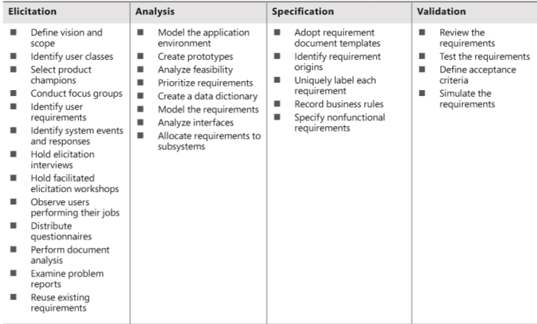
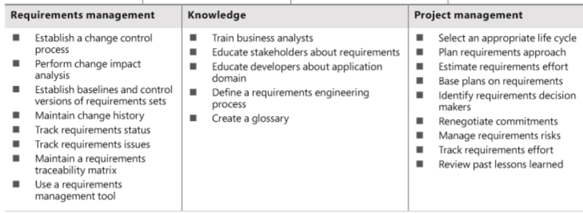
Requirements engineering good practices

Slide 18
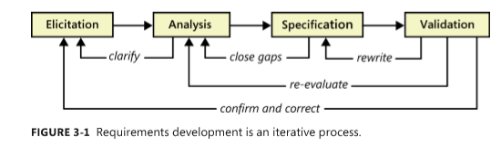
A requirements development process framework

Slide 19
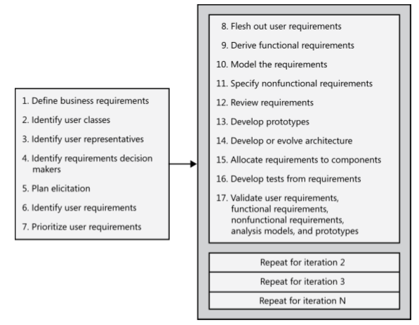
A representative requirements development process

Slide 20
Requirements elicitation
Define product vision and project scope
Identify user classes and their characteristics
Select a product champion for each user class
Conduct focus groups with typical users
Work with user representatives to identify user requirements
Identify system events and responses
Hold elicitation interviews
Hold facilitated elicitation workshops
Observe users performing their jobs
Distribute questionnaires
Perform document analysis
Examine problem reports of current systems for requirement ideas
Reuse existing requirements

Slide 21
Requirements analysis
Model the application environment
Create user interface and technical prototypes
Analyze requirement feasibility
Prioritize the requirements
Create a data dictionary
Model the requirements
Analyze interfaces between your system and the outside world
Allocate requirements to subsystems

Slide 22
Requirements specification
Adopt requirement document templates
Identify requirement origins
Uniquely label each requirement
Record business rules
Specify nonfunctional requirements

Slide 23
Requirements validation
Review the requirements
Test the requirements
Define acceptance criteria
Simulate the requirements

Slide 24
Requirements management
Establish a requirements change control process
Perform impact analysis on requirements changes
Establish baselines and control versions of requirements sets
Maintain a history of requirements changes
Track the status of each requirement
Track requirements issues
Maintain a requirements traceability matrix
Use a requirements management tool

Slide 25
Knowledge
Train business analysts
Educate stakeholders about requirements
Educate developers about the application domain
Define a requirements engineering process
Create a glossary

Slide 26
Project management
Select an appropriate software development life cycle
Plan requirements approach
Estimate requirements effort
Base project plans on requirements
Identify requirements decision makers
Renegotiate project commitments when requirements change
Analyze, document, and manage requirements-related risks
Track the effort spent on requirements
Review lessons learned regarding requirements on other projects

